Slide 1

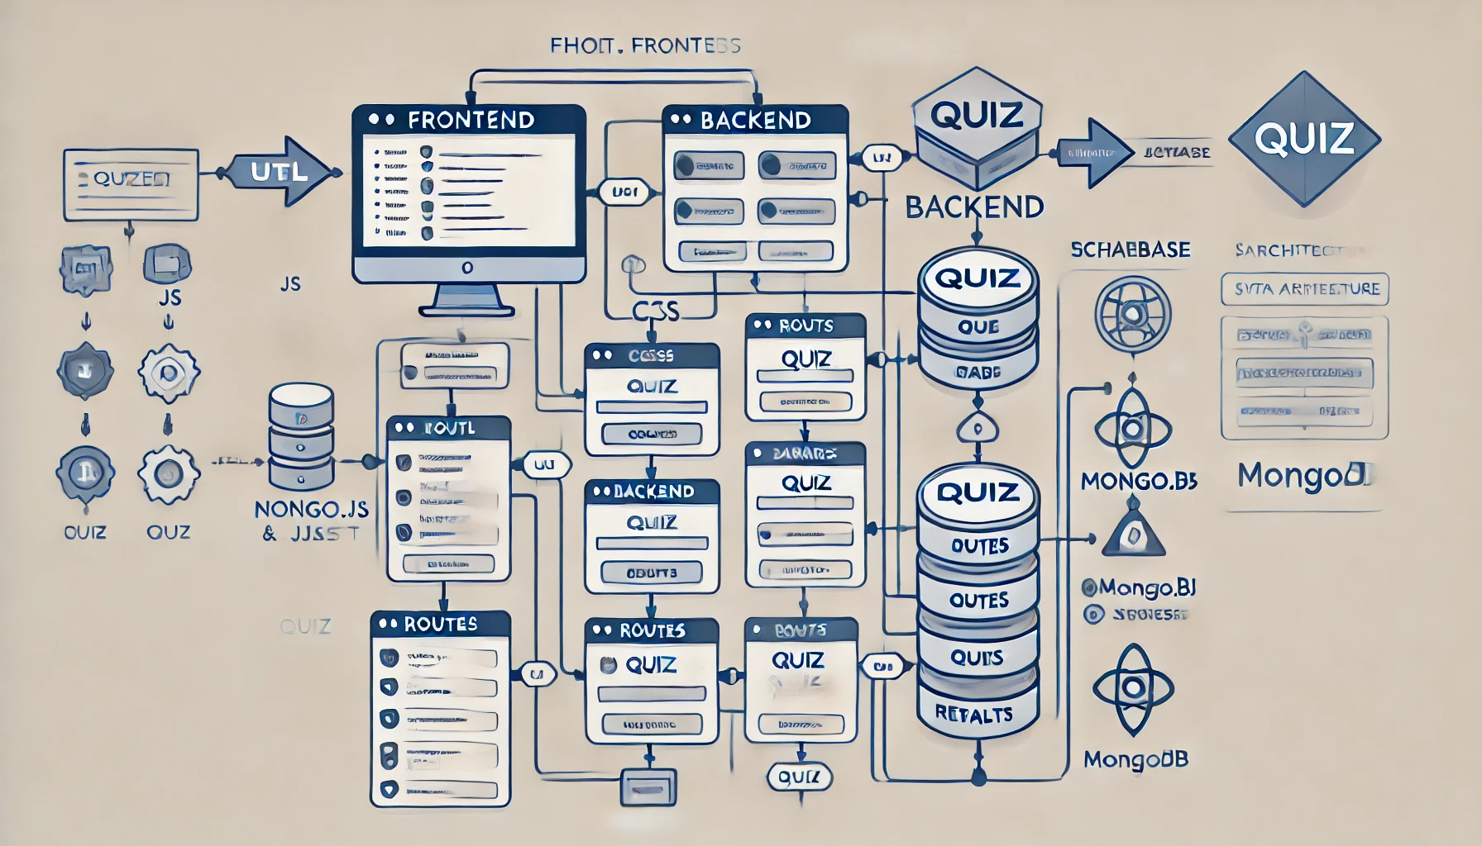
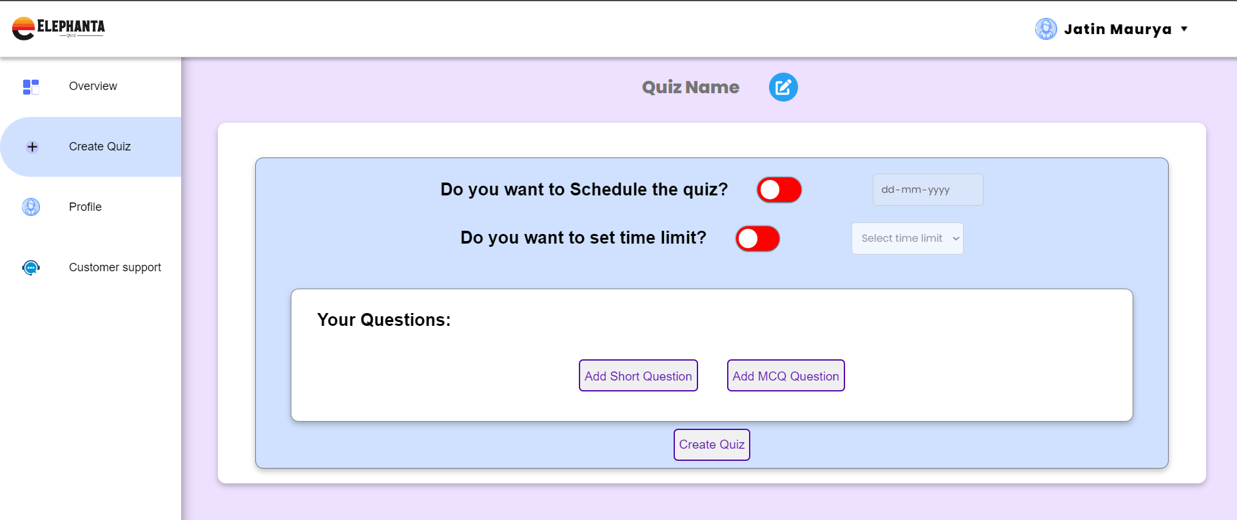
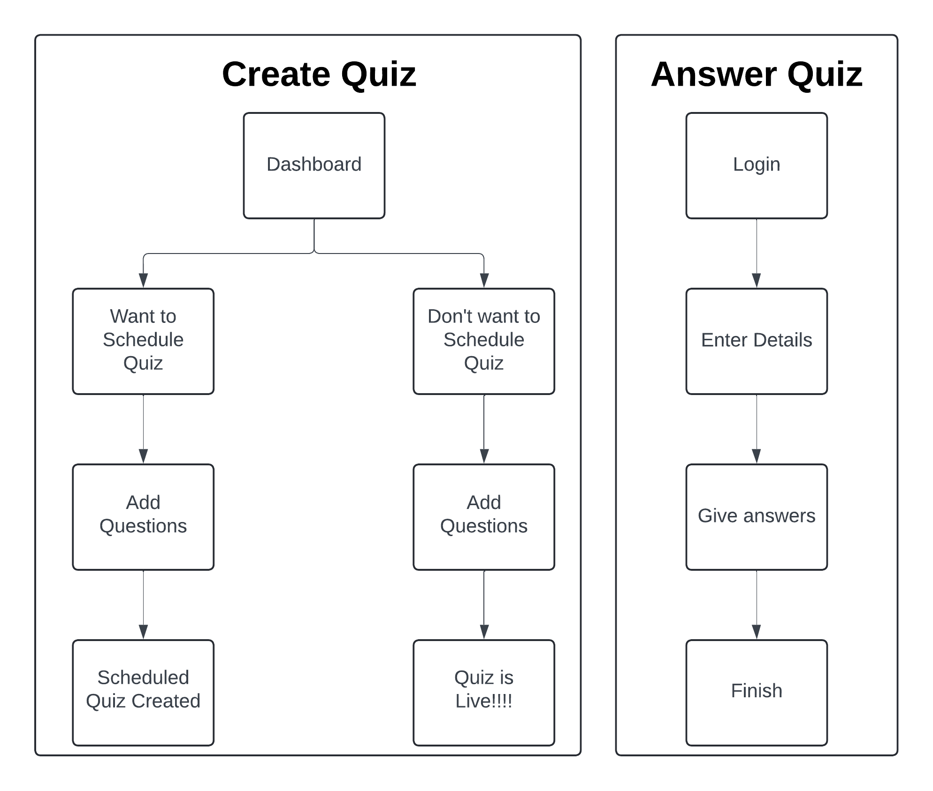
COT-P1 | Elephanta Quiz
Silver Oak College Of Computer Application,
SOCCA, SOU
1. Jatin Maurya (2304030100809) | 2. Falguni Solanki (2304030101696)
3. Henil Davariya(2304030100292)
INTRODUCTION
SYSTEM ARCHITECTURE
The Elephanta Quiz is a dynamic web-based platform designed to create, schedule, and manage quizzes efficiently, catering to various audiences. It offers users a range of advanced features such as real-time tracking, time-bound questions, and a robust validation system to ensure a smooth and secure experience. Developed using modern technologies like HTML, CSS, JavaScript, Node.js, Express.js, and MongoDB, the platform delivers high performance and an interactive user experience. Users can design engaging quizzes with multiple question types, set up schedules for future dates, and access a well-organized dashboard to view quiz details and statistics. With its user-friendly interface and diverse functionalities, Elephanta Quiz is ideal for educational assessments, corporate training, and general quizzes, providing a comprehensive solution for quiz management.
GOALS & OBJECTIVES
To provide an interactive and user-friendly quiz creation platform.
To allow users to create, edit and schedule quizzes with ease.
To implement advanced functionalities like time-bound questions and a robust validation system.
To enhance the user experience through real-time tracking and a dynamic dashboard.
TECHNIQUES USED
Frontend: HTML, CSS and JavaScript
Backend: Node.JS, Express.JS
Database: MongoDB
IMPLEMENTATION
Developed a feature-rich quiz website allowing users to create, schedule and manage quizzes.
Integrated various functionalities such as time limit, read only modes and a customer support page. HTML, CSS, JavaScript, Node.JS, Express and MongoDB for implementation.
ALGORITHM USED
Dynamic Quiz Creation Algorithm: Used to create and schedule quizzes with options for short and Multiple Choose Questions.
Real time Validation Algorithm: Validates quiz entries and monitors time limits.
Block Diagram / Circuit diagram/ Drawings
FUTURE SCOPE
Integrate additional question types such as true/false and image-based questions.
Implement a scoring system with leaderboard functionalities.
Add user authentication for secure access and personalized experiences.
CONCLUSION
The Elephanta Quiz website successfully provides a dynamic platform for comprehensive quiz management with intuitive and user-friendly features. It enables seamless scheduling of quizzes, allowing users to set up sessions in advance and manage them efficiently. The platform also offers real-time tracking, making it easy to monitor quiz progress and analyze performance. Furthermore, the robust validation system ensures that all inputs and actions are secure and error-free, adding an extra layer of reliability to the platform. These features collectively contribute to a smooth and engaging user experience, making Elephanta Quiz a versatile and effective tool for both quiz creators and participants.

